Slide 1


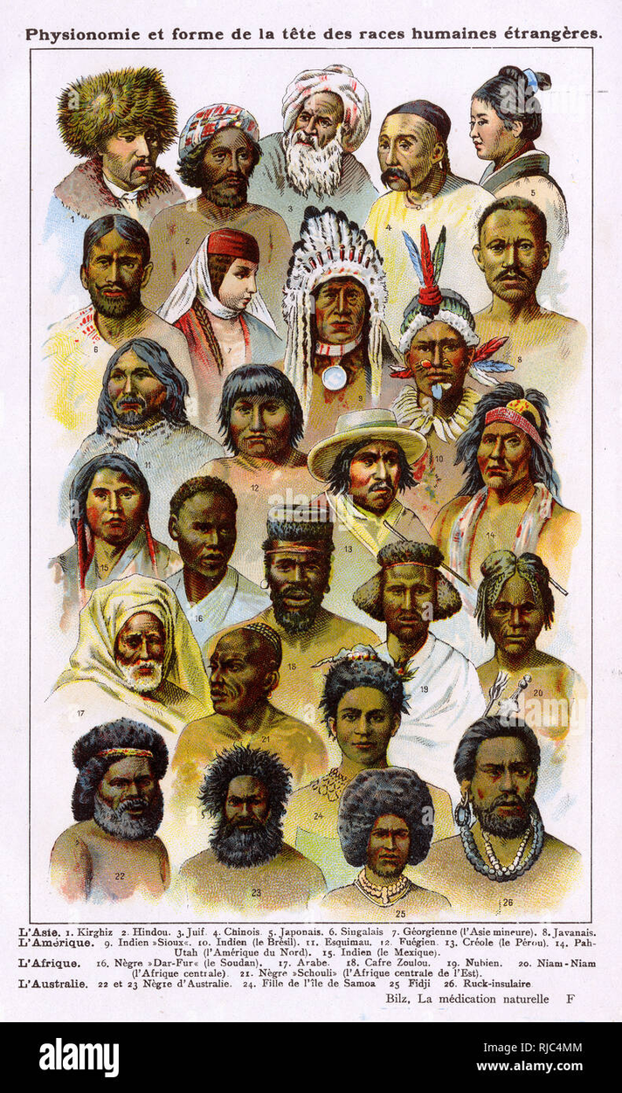
Indigenous People’s Rights Indicators
Ethical Finance | Group 11

Slide 2
Table Of
CONTENTS
01
Shareholder Activist’s Argument
02
Board’s Rebuttal
03
Academic Critique & Value Case
04
Industry Comparison
05
Improved Proposal & Rebuttal
06
Appendix

Slide 3

Overview
Proposal was submitted in response to JPMorgan’s repeated financing of projects linked to Indigenous rights violations.
Overview
2
Trigger
Cases
Proposal submitted by United Church Funds, an investment management company catering to the United Church of Christ demanding a report on JPMorgan’s Indigenous Rights policies & performance indicators.
J P Morgan’s funding linked to projects like Dakota Access Pipeline,Enbridge Line 5 etc.
Indigenous leaders cite cultural genocide; courts and referenda confirm rights violations.
Materiality
4
Risk
3
UCF argues that Indigenous rights violations expose firms to litigation, project shutdowns, and reputational backlash.
UCF highlights that JPMorgan’s policies lack a clear enforcement framework for FPIC.
Indigenous rights violations often lead to significant losses due to local organized resistance, e.g. loss of $1.2b from Yasuni Park refinery.
UCF proposes proactive governance accountability, using clear, measurable indicators.

Slide 4
Prior History of High-Risk Financing
01
JP Morgan has financed projects that violate Indigenous rights, including the Dakota Access Pipeline and Enbridge’s Line 3 and Line 5.
02
Line 5 has been called “cultural genocide” by Indigenous leaders and was found to be operating illegally on tribal land since 2013.
03
JPMorgan is also the top financier of oil and gas operations in the Amazon, facing ongoing protests.
04
JPMorgan back Gran Tierra Energy, linked to Indigenous rights violations in Colombia, and PetroAmazonas, which operates in Yasuni UNESCO Reserve despite Indigenous opposition and a 2023 national vote to halt drilling.
05
Enbridge, a major JPMorgan client, has repeatedly failed to secure free, prior, and informed consent (FPIC) from affected communities.

Slide 5
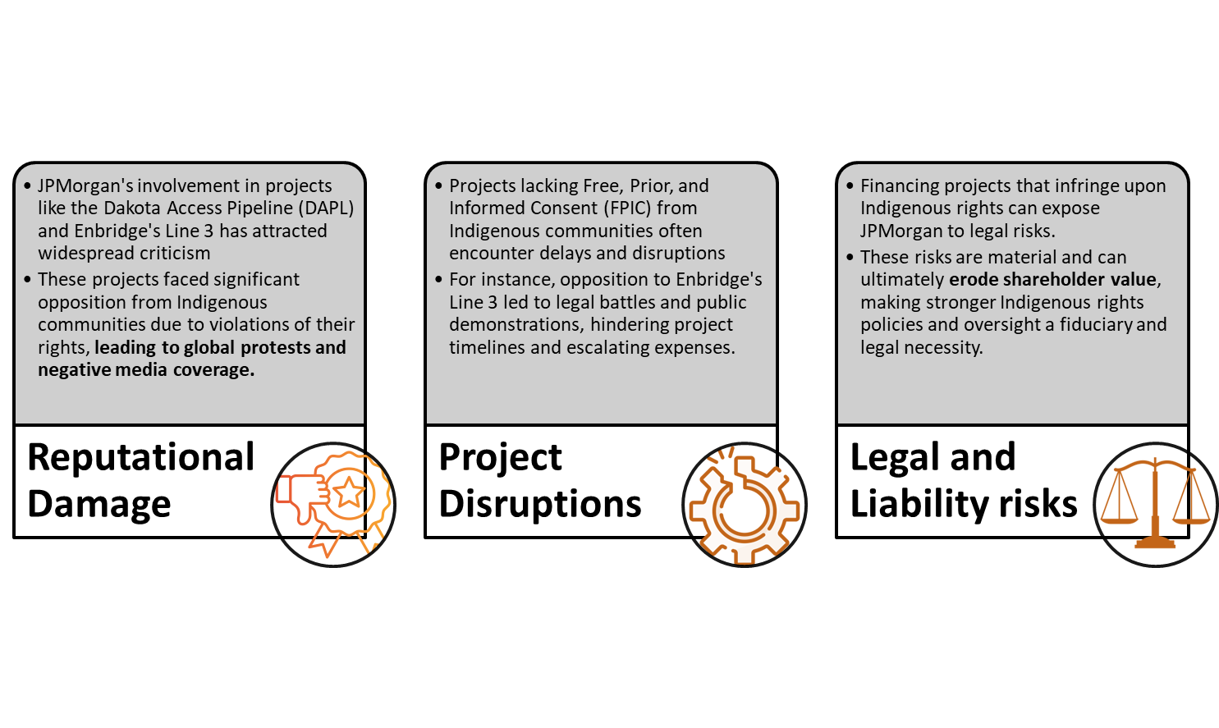
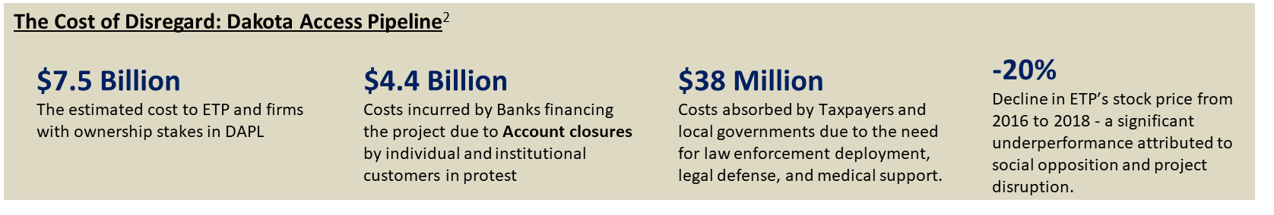
The Risk Chain of Rights Violations

Slide 6





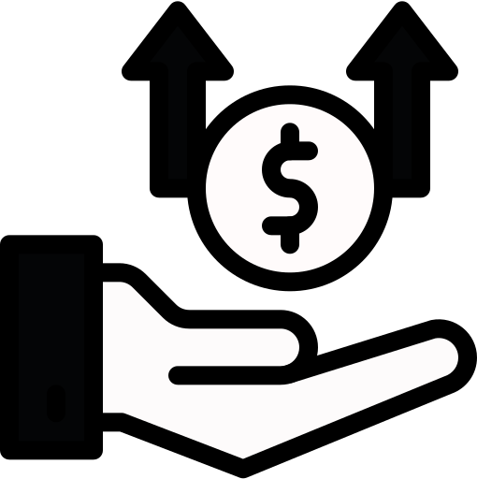
Existing Safeguards
The Board argues that current policies such as adoption of the IFC Performance Standards and Equator Principles provide sufficient protection and operational guidance.
Disputed Claims by Activists
The rebuttal asserts that the proposal relies on inaccurate or exaggerated allegations, referencing sources that are "subjective" and not aligned with shareholder interests.
Board’s Response
E&S Due Diligence
Risk management process includes assessing clients’ environmental and social (E&S) matters, including those related to Indigenous Peoples’ rights
“We support the fundamental principles of human rights across all our business lines and regions, guided by internationally recognized standards. Our existing policies, due diligence processes, and risk frameworks already address the concerns raised - making the requested report unnecessary.”
Rights Commitment
The Board reaffirmed JPMorgan’s alignment with global human rights norms, citing adherence to UNGPBHR & UNUDHR .
- JPMorgan Chase & Co., 2024 Proxy Statement
Proposal deemed Costly
Report would duplicate existing efforts. No credible evidence current process is failing. Would incur unjustified expense and offer little new insight to shareholders

Slide 7


STRATEGIC FRAMING
Decoding the Board Logic
Procedural Compliance over Impact
Complexity as a Deflection
Trust Us Framing
Defensive Posture to Maintain Control
Focused on internal policies, principles, and frameworks rather than engaging directly with real-world project-level outcomes
Asserted Indigenous rights metrics as “subjective”, shifting the debate from ethics to measurement feasibility
Reassured investors of adequate internal oversight and framed additional reporting to be unnecessary
Refused to co-create indicators, signaling reluctance to cede influence on external stakeholders and flexibility in financing decisions

Slide 8
Academic Critique & Value Case
Overview
Why Failing to Respect Indigenous Rights Is a Material Business Risk
1
Project Disruption & Conflict Risk
Indigenous disapproval can escalate into conflict; delays and project cancellations are costly.
Henisz et al. (2015): FDI on or near Indigenous land increases armed conflict.
Vedanta (India): Local protests stalled the Niyamgiri bauxite mine → ~$10bn loss (Chaturvedi, 2014).
GeoPark (Peru): Exited Block 64 after prolonged opposition → $70M+ in write-downs.
2
Legal & Political Risk
Lawsuits and court rulings can halt or reverse project approvals.
Occidental (Peru): 8-year lawsuit → costly settlement with Achuar communities.
Increasing legal exposure: e.g. EU Corporate Sustainability Due Diligence Directive.
Political backlash: referenda, land rights reforms (e.g., Colombia 2017, Liberia 2018) (Vejas, 2017).
3
Operational & Reputational Risk
Blockades and protests can delay or derail operations entirely.
DAPL case: Massive protests → $8.2bn cost overrun; Energy Transfer stock underperformed by 55% vs S&P 500 (2016–2018).
Media and civil society amplify reputational fallout from human rights abuses, even in remote areas.
¹ India Rejects Plan to Mine Bauxite in Niyamgiri Hills, Chaturvedi, S., Wall Street Journal, 2014;
² Colombian Town Chooses Farming Life Over a $35 Billion Gold Mine, Vejas, K., Wall Street Journal, 2017.

Slide 9
Academic Critique & Value Case
Overview
Why Proposal 7 Is a Value-Accretive Discipline Mechanism
1
Strengthens Internal Accountability
“You only get what you measure” – ESG performance improves when monitored.
Proposal 7 demands performance indicators, not vague policy statements.
Traceable indicators close gaps in JPM’s current frameworks → less wiggle room.
2
Reduces Adverse Selection Risk
Game-theoretic logic: good firms reveal more; bad firms don’t.
Transparency creates a separating equilibrium → better-informed investors.
Applies logic from Akerlof (1970) and ESG signaling models like Henide (2021).
3
Enhances Moral Salience → Better Decisions
Behavioral ethics: Reporting reframes Indigenous rights as an emotional moral dilemma.
Salient moral scrutiny discourages unethical decisions (e.g. Falk & Szech, 2013; Cohn et al, 2014).
Proposal serves as a "refocusing mechanism" for boards: move from non-emotional dilemma to a deontological question.
¹ The Market for “Lemons”: Quality Uncertainty and the Market Mechanism, Akerlof, G.A., The Quarterly Journal of Economics, 1970, 84(3), p. 488;
² Morals and Markets, Falk, A. and Szech, N., Science, 2013, 340(6133), pp. 707–711;
³ Green Lemons: Overcoming Adverse Selection in the Green Bond Market, Henide, K., Transnational Corporations, 2021, 28(3), pp. 35–63.

Slide 10
Academic Critique & Value Case
Overview
Strategic Framing – Ethical, Regulatory, and Market Alignment
1
Kantian Ethics & Universality
Can we universalize a world where banks ignore Indigenous rights? Likely not.
Deontological framing strengthens support: Rights are not just trade-offs.
2
Auditability = Accountability
Proposal 7 asks JPM to assess effectiveness, not just existence, of Indigenous rights frameworks.
Preempts greenwashing-like ESG risk: performance gaps will be exposed otherwise.
3
Regulatory & Market Fit
Thanassoulis (2023): Oligopolistic settings with low competition (e.g., major banks financing large projects) are prone to moral disengagement.
ESG risks get overlooked when no one is held responsible → Proposal helps correct that.
Cost of compliance is minimal; risk of non-compliance is large and rising.
¹ Competition and Misconduct, Thanassoulis, J., The Journal of Finance, 2023, 78(4), pp. 2277–2327;
² Business Culture and Dishonesty in the Banking Industry, Cohn, A., Fehr, E., and Maréchal, M.A., Nature, 2014, 516(7529), pp. 86–89.

Slide 11








PEER BANK COMMITMENTS TO INDIGENOUS RIGHTS
FPIC
Commitment
Indigenous Policy
Global
Mechanism for Grievance
Due
Diligence
Implementation Gap
Indirect (via Equator Principles)
Internal E&S screen
No FPIC metrics
No
No
IFC PS7, Equator Principles
Partial
Partial
Independent experts, risk reviews
No Indigenous consultation
UNGP, ILO, Equator
ESG Council + ESRPF
No FPIC outcome tracking
No
Ethics Hotline
Independent ESRM team, escalation protocols
IFC PS7
US Focused
No
Policy limited to U.S.
¹ Respecting the Rights of Indigenous Peoples: 2023 Report, Citigroup Inc., 2023; ² Indigenous Peoples Statement, Wells Fargo, 2024; ³ Human Rights Statement, Bank of America, 2024; ⁴ Human Rights, JPMorgan Chase & Co., 2025.

Slide 12
Peer Bank Commitments to Indigenous Rights Deep Dive
Overview
1
JPMorgan
Shareholder Outcome
JPMorgan relies on an internal Environmental & Social (E&S) screening process with no evidence of Indigenous community consultation or FPIC-specific protocols. It has not disclosed any project-level ESG enforcement data nor held shareholder votes on this topic. JPMorgan demonstrates the widest execution gap
Failed and then reversed in 2025!
2
Citigroup
Citigroup uses independent consultants and conducts annual credit reviews to flag high-risk clients, offering a more structured due diligence process. However, its 2024 Indigenous Rights report lacked direct input from affected communities, raising questions of legitimacy.
26.3% support
3
Bank of America
BoA operates a robust governance architecture with oversight from its ESG Council and a structured ESRPF framework. Yet, it lacks any Indigenous-specific reporting metrics for FPIC, weakening its practical impact.
No as focus became de-banking
4
Wells Fargo
Wells Fargo shows formal alignment with IFC PS7 and maintains an independent ESRM team for due diligence, including escalation protocols. However, its Indigenous Peoples Statement applies primarily to U.S. contexts, leaving Latin America and other geographies uncovered.
23.8% support
¹ Respecting the Rights of Indigenous Peoples: 2023 Report, Citigroup Inc., 2023; ² Indigenous Peoples Statement, Wells Fargo, 2024; ³ Human Rights Statement, Bank of America, 2024; ⁴ Human Rights, JPMorgan Chase & Co., 2025.

Slide 13




WHAT CAN J.P. MORGAN LEARN
Transparency and Accountability
Formal ESG Governance
Grievance and Consultation
Globalize Indigenous Rights Policies
JP Morgan must begin publishing detailed ESG metrics, including how many projects are flagged for Indigenous rights risks, and whether FPIC was respected.
This would bring it closer to peers like Citi and Wells, and build investor and community trust.
JPM should create a board-level ESG oversight body - similar to BoA’s Responsible Growth Council - to ensure accountability in financing decisions that affect Indigenous communities. This will anchor ESG risks at the highest strategic level.
JPM should ensure its Indigenous rights protections apply consistently across all regions, not just the U.S. This includes explicitly adopting global standards like IFC PS7 and UNDRIP
To prevent future conflict, JPM must introduce accessible grievance mechanisms and require documented Indigenous consultation for high-risk projects.

Slide 14



From Conflict to Collaboration – A Proposal
2024 Proposal Rejected
Activists demanded better tracking of Indigenous rights protections.
JPMorgan Board rejected the proposal citing, “Duplicative effort”, “Subjective sources”, “Existing safeguards already in place” etc
Cohn et al. (2014) and Falk & Szech (2013), rejected proposals framed as emotional, “subjective,” and dismissed
2025 Constructive Dialogue
UCF launched sustained engagement.
JPMorgan agreed to new disclosures in exchange for withdrawal.
FPIC and Indigenous risks now acknowledged in proxy supplement.
Chaturvedi (2014) explains disclosure in response to financial risk (like protests or litigation) leads to constructive engagement.
How strategic framing turned a rejected proposal into meaningful policy reform
Our Smarter Proposal
A risk-driven, standards-aligned reporting resolution.
Built on successful elements of the 2025 agreement.
Designed to succeed without confrontation.
What worked
Frame Indigenous rights as material financial risk.
Align proposal with existing internal policies (IFC PS7, FPIC, UNGP).
Avoid moral posturing; favor metrics + risk language.
1.Cohn, A., Fehr, E., & Maréchal, M. A. (2014). Business culture and dishonesty in the banking industry. Nature, 516, 86–89. Falk, A., & Szech, N. (2013). Morality and Markets. Science, 340(6133), 707–711.
2.Chaturvedi, R. (2014). Vedanta’s Niyamgiri mining project faces tribal resistance. The Economic Times.

Slide 15
Why Internal Processes Leave JPMorgan Exposed
Vague Commitments Without Enforcement
Black Box Due Diligence
Reforms Only Followed Pressure
Understanding
JPMorgan references international frameworks like IFC PS7 and UNDRIP, but fails to provide any enforcement detail. Terms like “may require” or “where appropriate” dilute responsibility. There are no hard guarantees around FPIC implementation, even in high-risk financing.
Despite an internal “Nature & Social” due diligence process, there is:
No public audit trail
No Indigenous consultation records
No disclosure of escalated cases
No data on how often FPIC is applied
Henisz et al. (2014) show that lack of transparency in high-risk zones increases operational delays
JPMorgan only updated its Human Rights Statement and proxy language after months of investor pressure from UCF, IASJ, and co-filers. These were not proactive improvements - they were reactive compromises. UCF engagement record (2025).
Without enforceable standards, measurable outputs, and public transparency, The internal ESG process remains a black box - vulnerable to risk, reputation loss, and shareholder scrutiny.
1 Henisz, W., Dorobantu, S., & Nartey, L. (2014). Spinning Gold: The Financial Returns to External Stakeholder Engagement. Strategic Management Journal, 35(12), 1727–1748.
2 United Church Funds (UCF). (2025). Shareholder Engagement Record with JPMorgan Chase – Indigenous Rights Agreement. Investor Advocates for Social Justice & UCF Statement, April 2025.

Slide 16



Our Shareholder Proposal
Adopt Risk-Based FPIC Indicators
Include Escalation in ESG Reporting
Publish Grievance Pathways
Formalize Internal Accountability
What we’re asking:
JPMorgan should publish annual disclosure of how often Indigenous Peoples’ Free, Prior and Informed Consent (FPIC) was assessed, escalated, and implemented.
What we’re asking:
Add a dedicated FPIC escalation section in JPMorgan’s ESG reporting - outlining number of transactions reviewed, raised, and modified or rejected based on Indigenous rights risk.
What we’re asking:
Disclose the existence of accessible grievance mechanisms for Indigenous communities, and whether these were invoked, resolved, or escalated.
What we’re asking:
Create a board-level Indigenous Rights Risk Subcommittee, or formally integrate this oversight into the ESG Council, with regular reporting duties.
Why this works:
This turns vague commitments into measurable practices - building from the 2025 proxy supplement while closing the gap in project-level transparency.
Why this works:
Fixes the lack of community voice, a main UCF critique. Aligns with successful peer practices like ethics hotline, Empowers Indigenous stakeholders with formal recourse, reducing reputational and legal risk for JPMorgan.
Why this works:
This reflects JPM’s Responsible Growth Council model and ensures long-term integration, not reactive reform. It costs nothing but signals commitment.
Why this works:
Directly responds to the current “black box” due diligence problem. Builds on the Nature & Social team’s existing mandate, so it’s not duplicative, adding measurable oversight.

Slide 17
Preempting Board Pushback – Why This Proposal Is Different
Objection 1
This duplicates existing safeguards
Objection 2
No added shareholder value
1
2
This proposal builds on existing frameworks, not duplicates them. It formalizes enforcement (FPIC metrics, escalation logs) using current ESG channels like the Nature & Social team and Responsible Growth Council - ensuring operational continuity with improved oversight.
Investor demand is rising for quantifiable ESG risk disclosure. These proposals create clear audit trails for Indigenous rights risks — addressing material financial impacts tied to project delays, litigation, and reputational fallout (e.g., DAPL, Yasuni).
Objection 3
Subjective and hard to implement
4
Objection 4
No precedent for oversight
3
Proposal uses globally accepted standards (IFC PS7, UNGP, UNDRIP) and objective data like number of escalations or grievance cases. These are already used by peers (e.g., Wells, Citi) — JPM can lead with measurable leadership. This shifts the debate from ethics to verifiable risk governance, making the proposal both credible and actionable.
Bank of America’s ESG Council already performs similar oversight. JPMorgan’s own Responsible Growth Council is a natural fit for formalizing Indigenous risk governance — cost-neutral but high impact. Institutionalizing this oversight signals long-term ESG maturity to investors and rating agencies alike.

Slide 18

CONCLUSION
To conclude, this proposal isn’t about moral posturing or duplicating policy. It’s about upgrading JPMorgan’s ESG infrastructure to match the risk reality of today’s financial landscape. We’ve seen how opaque internal reviews, vague FPIC commitments, and reactive disclosures, even when well-intentioned, leave the firm exposed to legal, reputational, and operational risks.
By adopting this proposal, JPMorgan won’t just reduce risk, it can lead its peers in translating Indigenous rights from abstract principle into practical accountability. That leadership, in turn, protects long-term value for shareholders, communities, and the firm alike.
THANK YOU

Slide 19
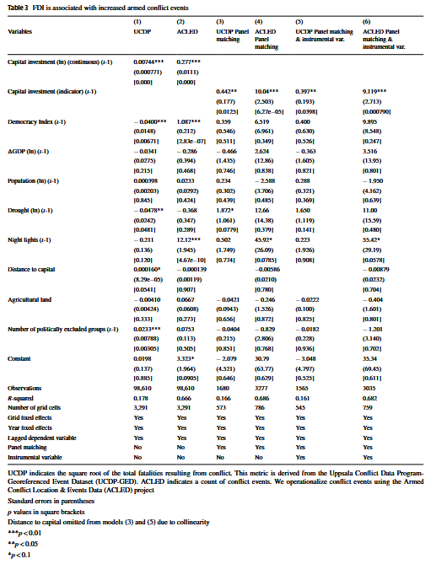
Appendix
Appendix 1: Regression estimates showing that foreign direct investment (FDI) in Indigenous-held or adjacent territories is significantly associated with increased armed conflict, using multiple specifications and conflict event datasets (UCDP and ACLED).
Overview
Source: Jamison, Tadmor, & Henisz (2025), Journal of International Business Studies.

Slide 20
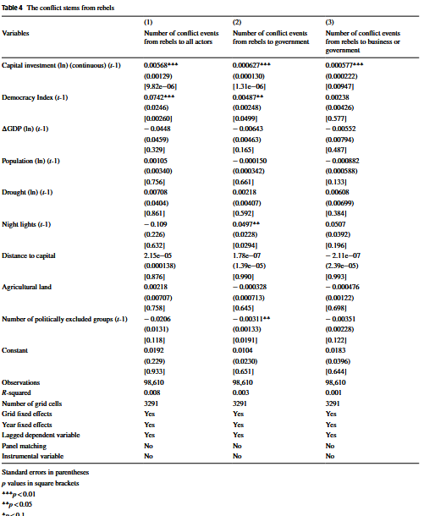
Appendix
Appendix 2: Regression estimates indicating that increases in FDI are significantly associated with conflict initiated by rebel groups—supporting the view that such investments trigger mobilization against both governmental and corporate actors in Indigenous-adjacent regions.
Source: Jamison, Tadmor, & Henisz (2025), Journal of International Business Studies.
Overview

Slide 21



Team
Siddharth Kumar Balasubramium
Prashanth Nair
Nitin Lohia
Prabhav Gupta
Shreyas Urgunde
Karthikeyan Muthu
Pranav Chandvania
Samyak Jajawara
Adel Abou Jaber
Jay Mehta

